Slide 1


ANALYSIS OF S&P 500 COMPANIES
BY
NITHYA SANTHOSHINI K
BATCH - 263

Slide 2
ABOUT ME
NAME : NITHYA SANTHOSHINI K
EDUCATION: BTECH , CSE 23
Background: I hold a recent B.Tech degree in Computer Science and have a keen interest in data analytics, software development, and cloud engineering.
Why Data Science: I am passionate about learning Data Science to explore its vast domain and leverage my skills in areas such as cloud engineering, data analytics, and software development. Specifically, I am excited about contributing to cutting-edge projects in these fields.
Work Experience: I am a recent graduate and currently do not have work experience. However, I have joined Innomatics Research Labs to gain practical exposure to data science and further my career in this field.
Notes:
I'm a recent Computer Science graduate eager to dive into Data Science. My passion lies in data analytics, software development, and cloud engineering. Although dont have any work experience I'm taking strides by joining Innomatics Research Labs to gain hands-on exposure and propel my career in this exciting field.

Slide 3

CONTENTS
Business Problem and Use case domain
Objective of the Project
Web Scraping
Summary of the Data
Exploratory Data Analysis:
Data Cleaning
Univariate Analysis
Bivariate Analysis
Key Business Questions
Conclusion (Key finding overall)
Q&A
Experience/Challenges

Slide 4
BUSINESS PROBLEM AND USE CASE DOMAIN
Business Problem Statement:
Analysis Of S&P 500 Companies
Identify key factors and trends across S&P 500 companies to inform strategic investment decisions, assess market risks, and uncover potential growth opportunities.
Introduction
Understanding the S&P 500:
A market-capitalization-weighted index of the 500 largest U.S. publicly traded companies.
Represents a broad snapshot of the U.S. economy and is a widely used benchmark for investment performance.
Notes:
s&p 500 it's a market-capitalization-weighted index that encapsulates the 500 largest U.S. publicly traded companies. This index gives us a broad snapshot of the U.S. economy and serves as a widely recognized benchmark for investment performance.Now, why are we delving into this analysis? Our goal is to identify key factors and trends across S&P 500 companies, in order to inform strategic investment decisions, assess market risks, and uncover potential growth opportunities.

Slide 5
OBJECTIVE OF THE PROJECT:
Investment Portfolio Optimization:
Analyze sector and subindustry performance to identify promising investment opportunities.
Assess company growth potential and risk factors based on financial indicators.
Market Risk Assessment:
Monitor trends in company performance across sectors to identify potential economic risks.
Anticipate market shifts and make informed portfolio adjustments.
Industry Analysis and Growth Opportunities:
Explore emerging industries and subindustries with high growth potential.
Identify potential acquisition targets or strategic partnerships.
Geographic Insights:
Analyze company distribution and performance across different regions.
Understand regional economic strengths and weaknesses.

Slide 6
WEB SCRAPING:
Web Scraping: Data Mining Beyond APIs
Automated method to collect large amounts of data from websites.
Transforms unstructured HTML data into structured formats for analysis.
Ideal for websites lacking structured data access
Methods:
APIs (if available)
Custom code
Popular tools:
Python: versatile language with dedicated libraries.
Scrapy: robust web crawling framework for scraping & APIs.
Beautiful Soup: parses HTML, simplifies data extraction and manipulation.

Slide 7

DATA COLLECTION:
• Wikipedia - List of S&P 500 companies website has the information related to S&P 500 Companies
• 'https://en.wikipedia.org/wiki/List_of_S%26P_500_companies’
LIBRARIES USED:
WEB SCRAPING TOOLS
PYTHON
BEAUTIFUL SOUP
REQUESTS
PANDAS
REGULAR EXPRESSION
MATPLOTLIB
SEABORN
PLOTLY

Slide 8
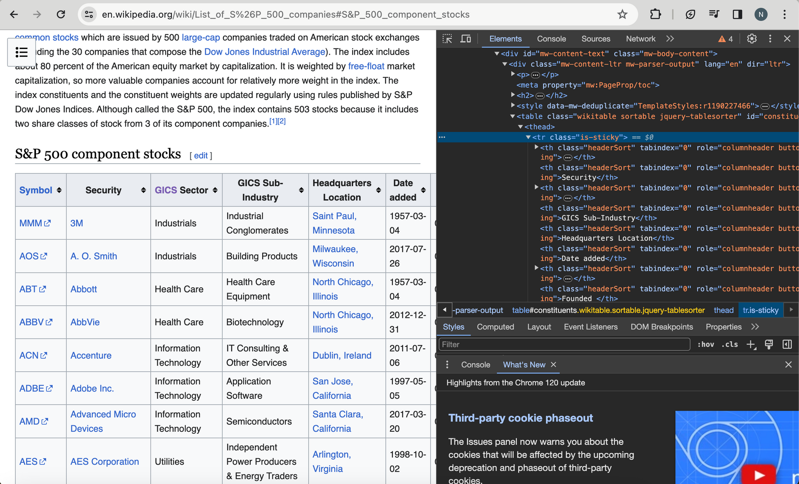
WEBSITE

Slide 9
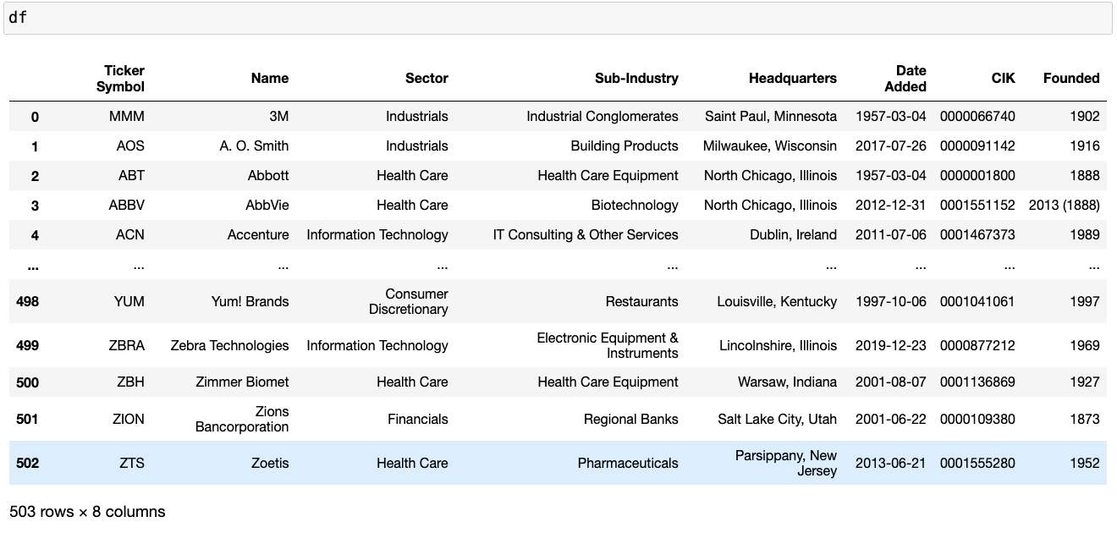
RAW DATA

Slide 10
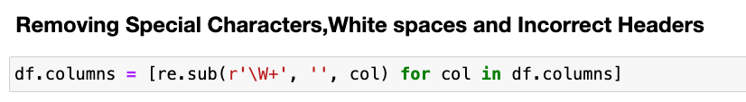
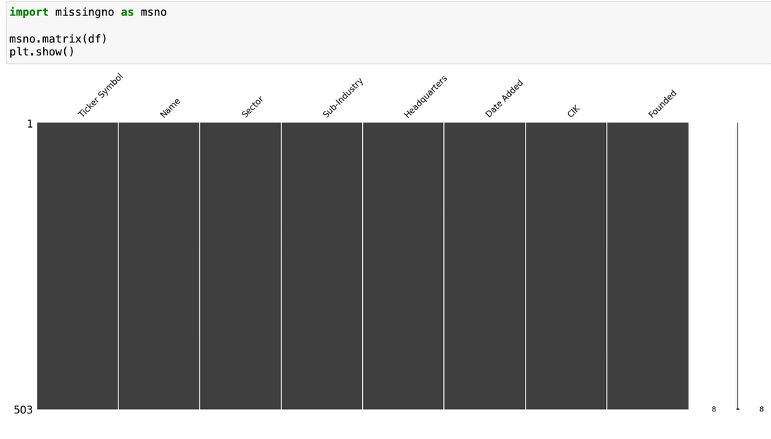
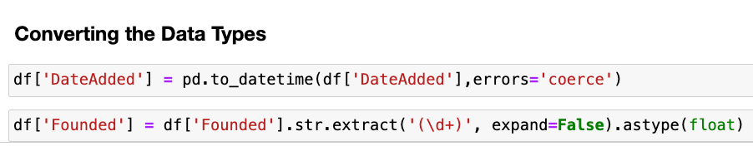
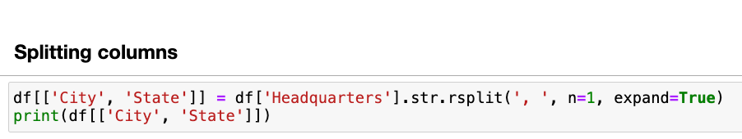
EXPLORATORY DATA ANALYSIS:
Data Cleaning Steps:
Finding the missing values
Removing Special Characters,White spaces and Incorrect Headers
Converting the Data Types
Splitting columns

Slide 11
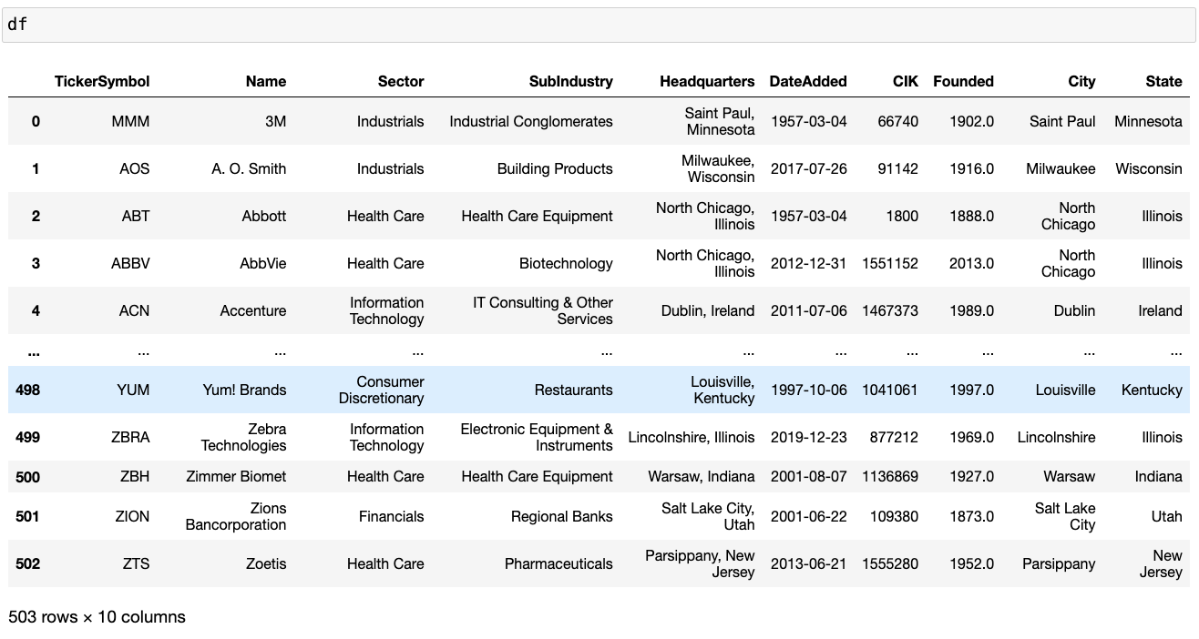
CLEANED DATA

Slide 12
SUMMARY OF THE DATA
Key Data Elements:
TickerSymbol: Unique identifier for each company.
Name: Company name.
Sector: Industry classification (e.g., Information Technology, Health Care, Financials).
SubIndustry: More granular industry classification.
Headquarters: Location of company headquarters.
DateAdded: Date of inclusion in the S&P 500 index.
CIK: Central Index Key, a unique identifier assigned by the SEC.
Founded: Year of company founding.
City: Headquarters city.
State: Headquarters state.

Slide 13
DATA VISUALIZATION
Univariate data: Univariate data consists of only one variable. The information deals with only one quantity that changes.
Categorical
Numerical
Bivariate Analysis: Bivariate data involves two different variable. The analysis is done to find out the relationship among the two variables.
Categorical and Categorical
Categorical and numerical
Numerical and numerical
MultiVariate analysis: Multivariate analysis have required when more than two variables have to be analysed simultaneously.
Two Categorical and one Numerical
Two Numerical and one Categorical
Three or more Numerical

Slide 14
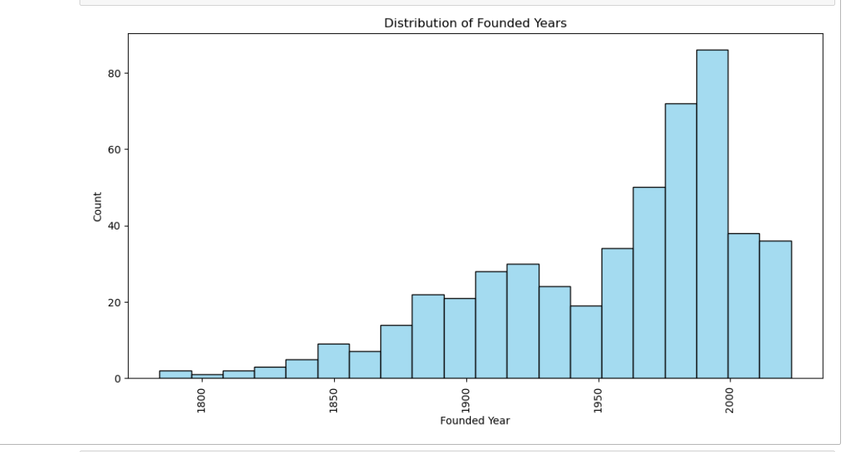
UNIVARIATE ANALYSIS
HISTOGRAM
The graph shows a consistent increase in the number of U.S. companies founded over time.
The peak founding year is 2000, suggesting a significant surge in entrepreneurial activity.

Slide 15
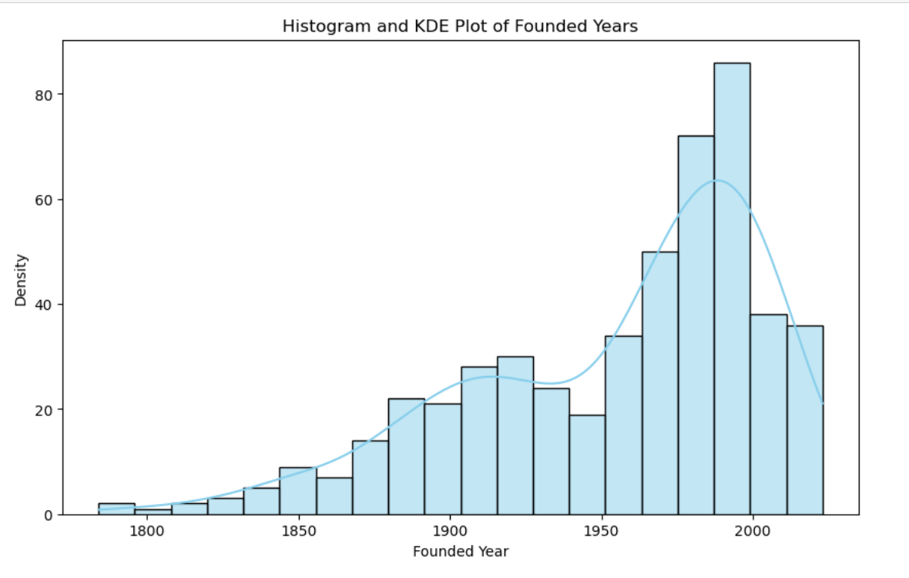
A decline in company founding is observed since 2007, signaling a potential shift in entrepreneurial dynamics.
Notes:
kernel density estimation (KDE) is the application of kernel smoothing for probability density estimation,

Slide 16
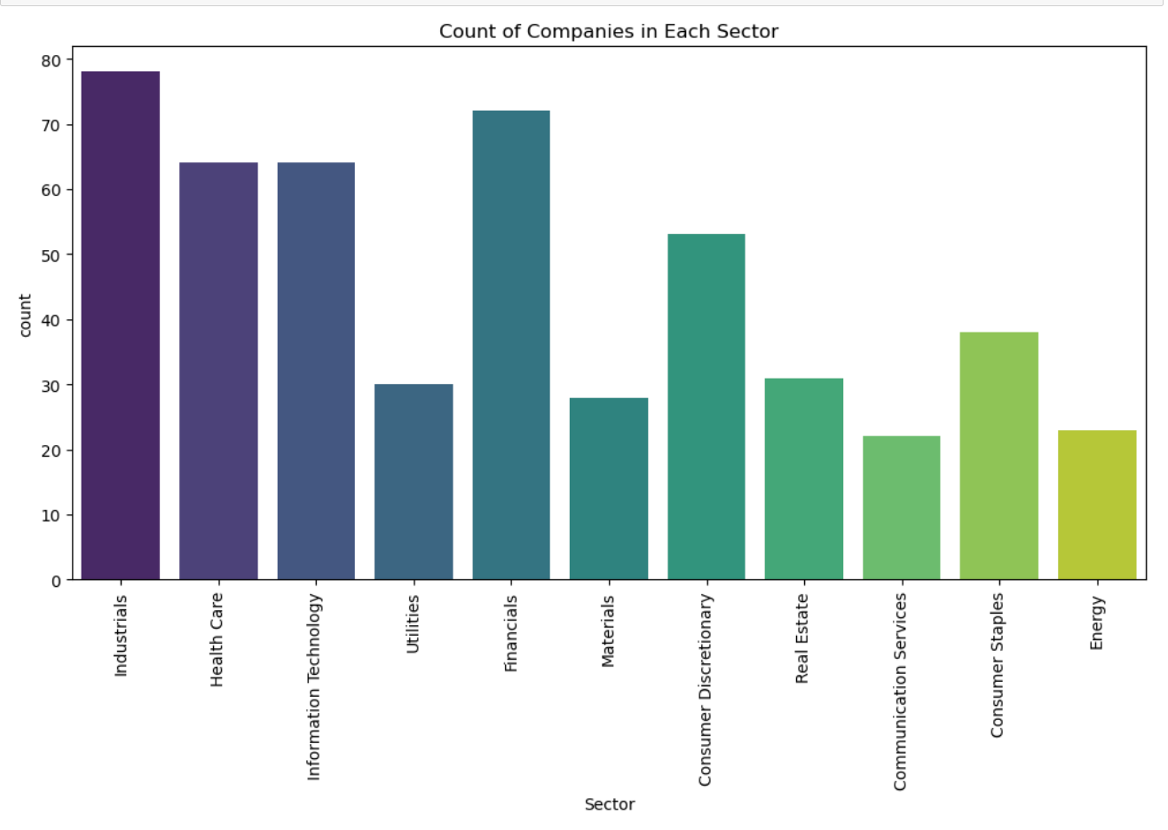
COUNT PLOT
Overall Growth: Companies across all sectors are increasing, indicating a growing economy.
Sector Leaders: Healthcare, information technology, and financials are leading sectors.
Smaller Sectors: Consumer staples and energy have fewer companies, possibly facing challenges or being more mature.

Slide 17
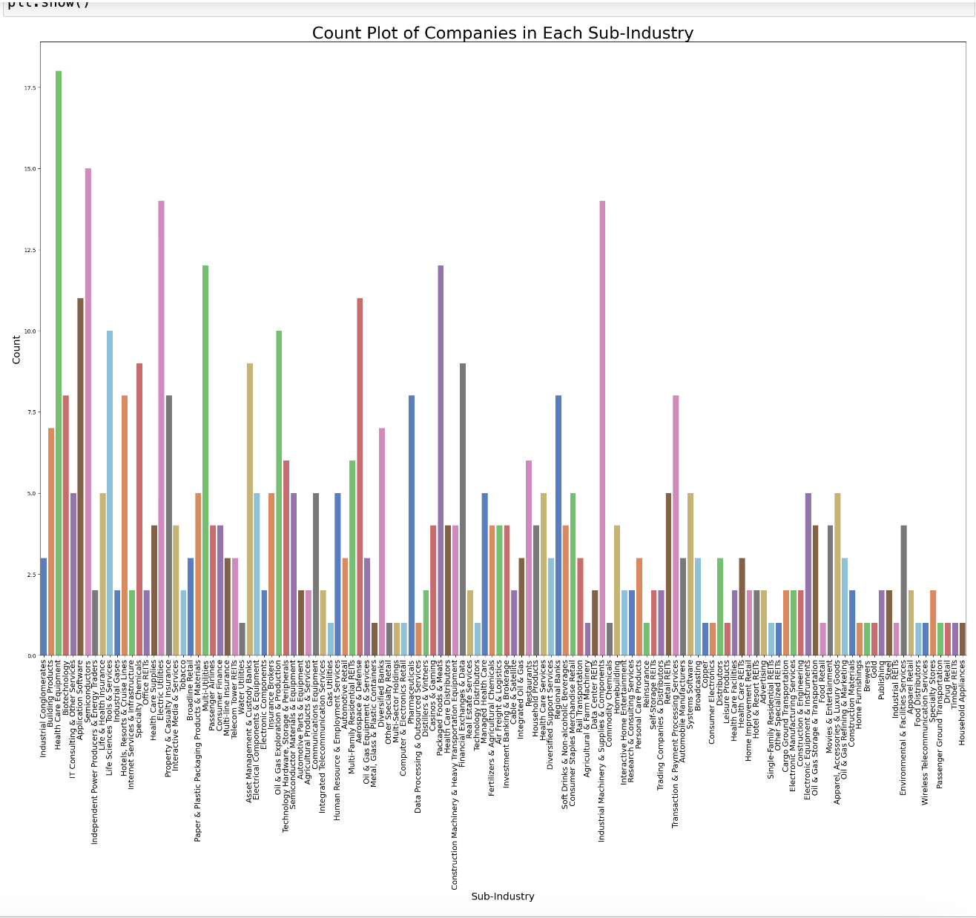
Notes:
Health care and industry has the highest count of companies

Slide 18
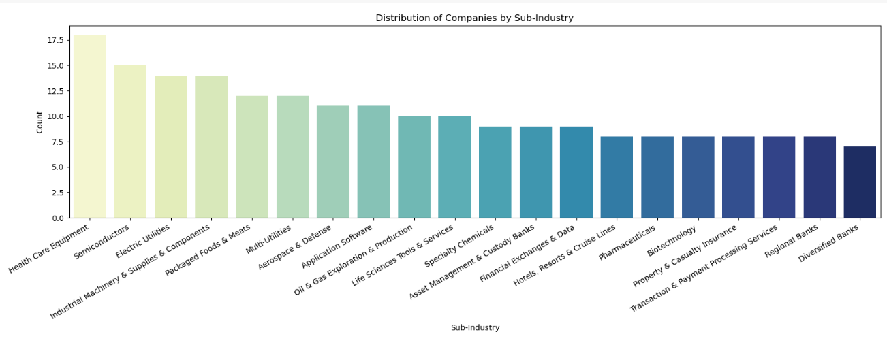
COUNTPLOT

Slide 19
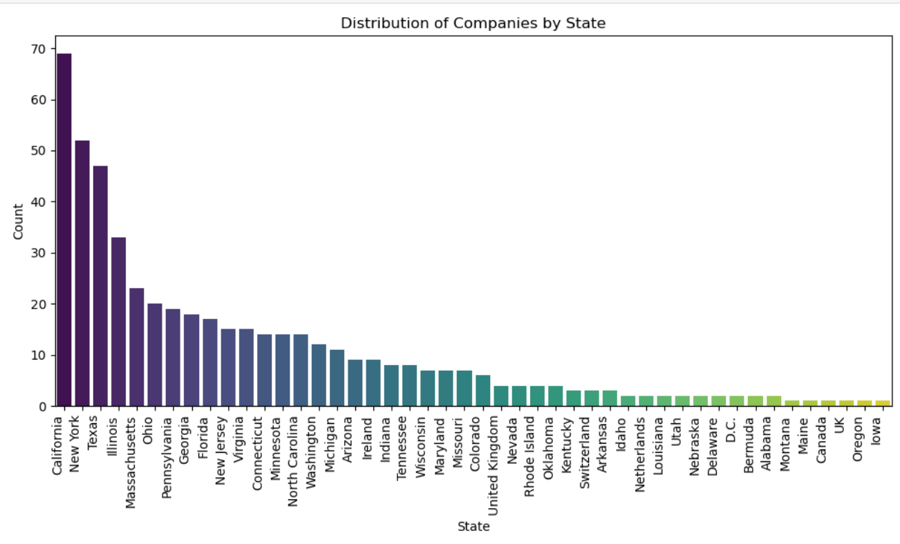

Slide 20
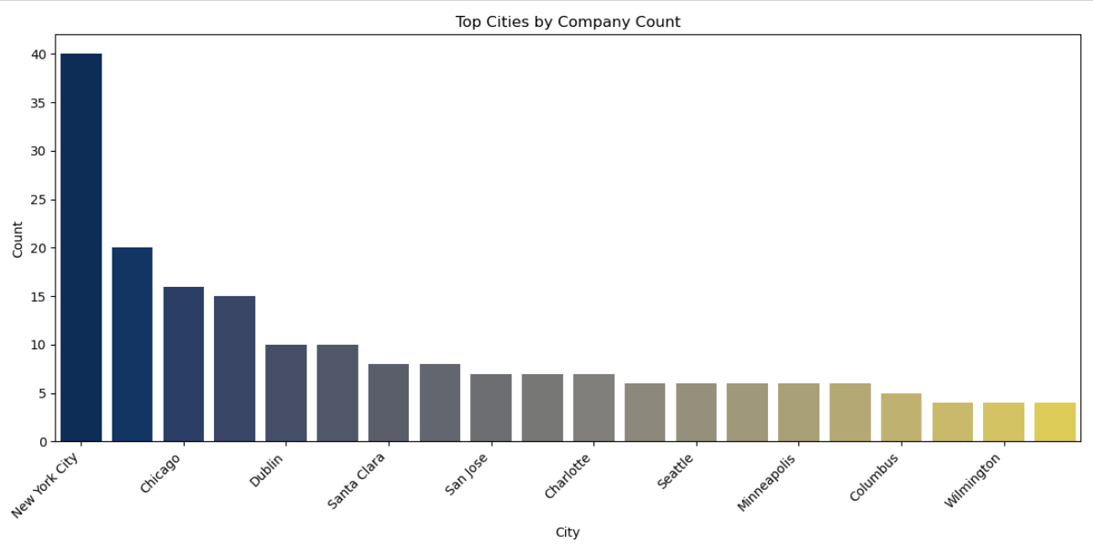
COUNTPLOT

Slide 21
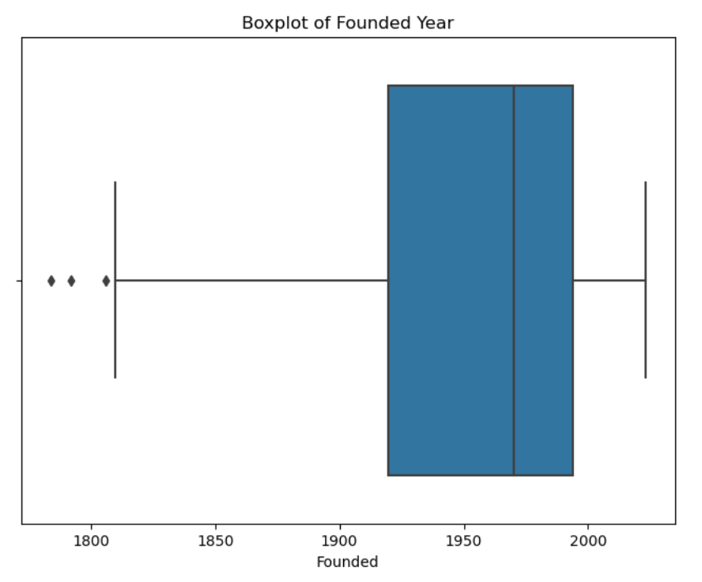
Median Age: The majority of startups were founded between 2010 and 2015, with the median year likely falling within this range.
Founding Year Range: Startups in the dataset span a wide range of years, from the early 1900s to 2020, indicating a diverse mix of young and established companies.
Outliers: A few startups fall outside this range (before 1900 or after 2020), potentially indicating data errors or representing rare cases of very old or new startups.
BOXPLOT

Slide 22
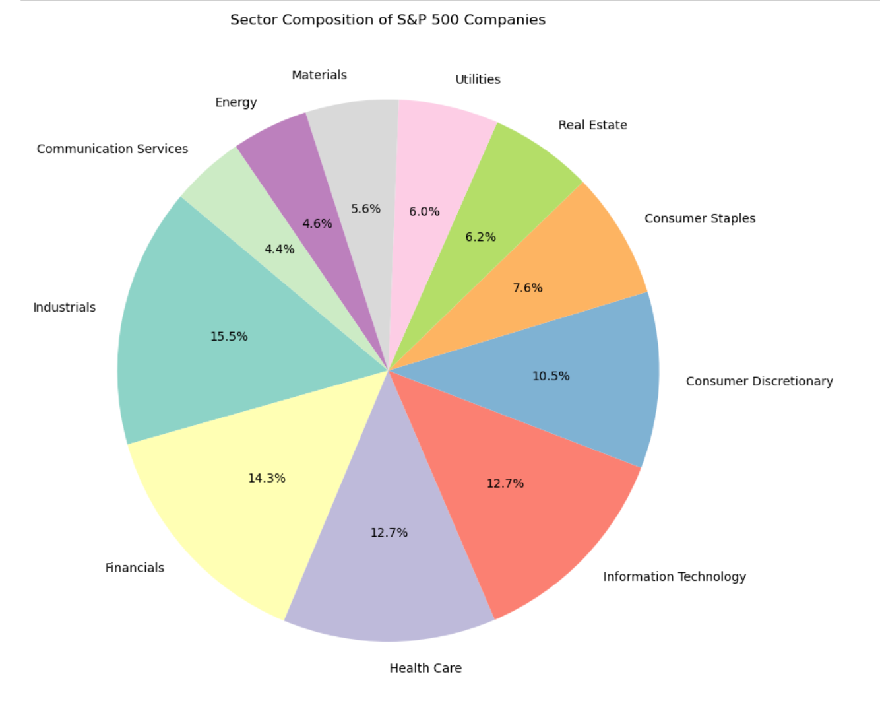
IT Growth: The IT sector has experienced substantial growth, mirroring its increasing influence in various aspects of our lives.
Dynamic Composition: The S&P 500's composition evolves with changing company sizes, emerging industries, and economic shifts.
Sector Performance: Sectors exhibit diverse performances influenced by economic conditions; e.g., IT historically sees high growth, while Utilities provide stability.
PIEPLOT

Slide 23
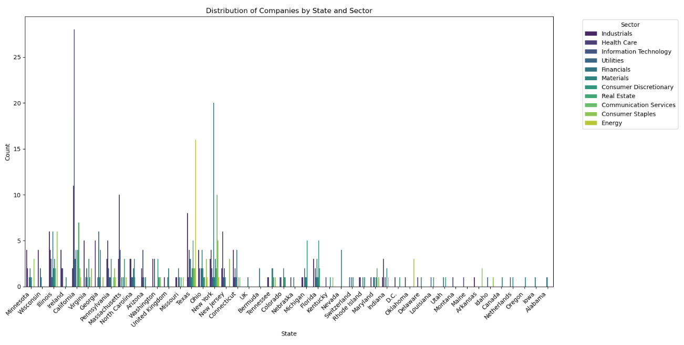
BIVARIATE ANALYSIS
COUNT PLOT
OF
DISTRIBUTION OF COMPANIES BY STATE AND SECTOR

Slide 24
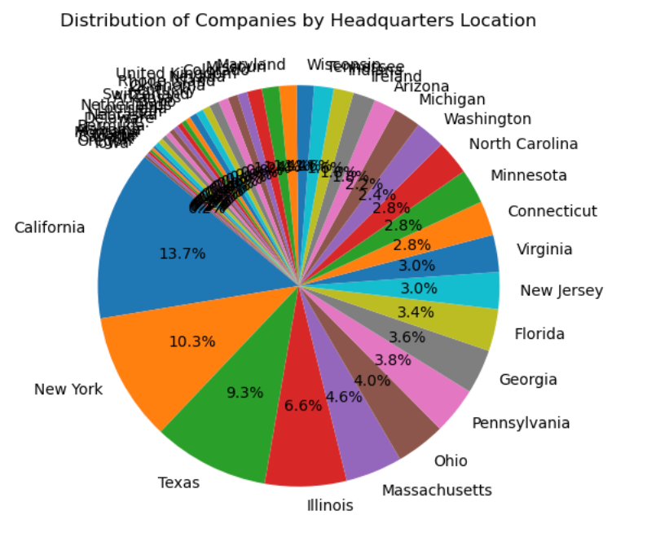
PIEPLOT

Slide 25
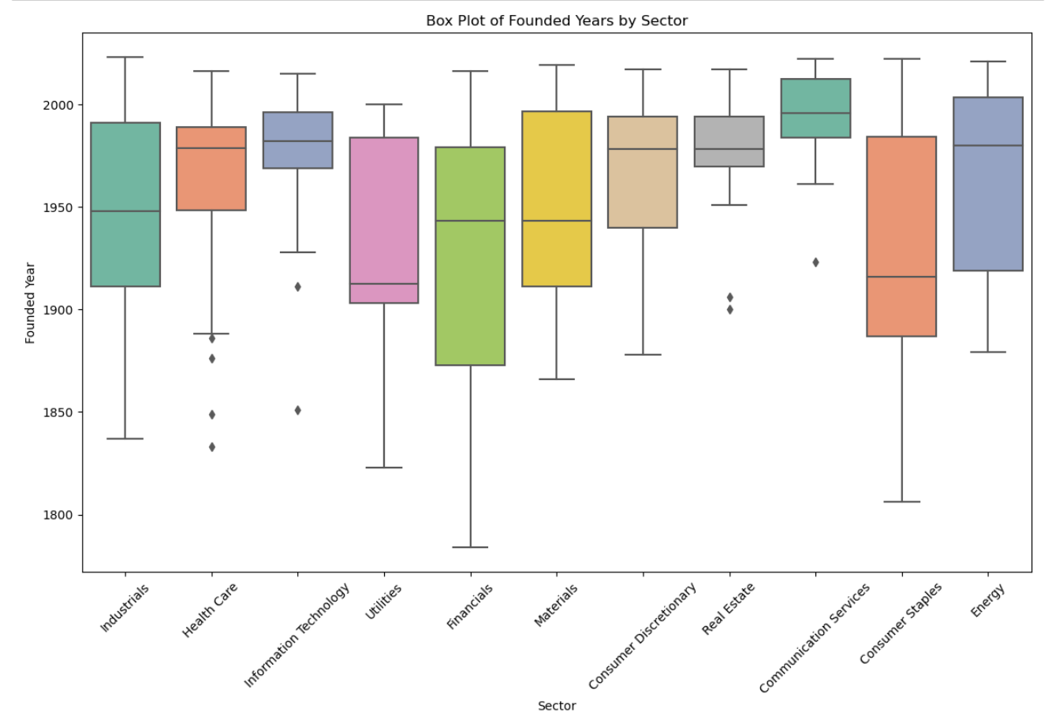
Industrials: Widest range of data points with lower median and more outliers compared to other sectors.
Consumer Discretionary: Highest median with the fewest outliers.
BOXPLOT

Slide 26
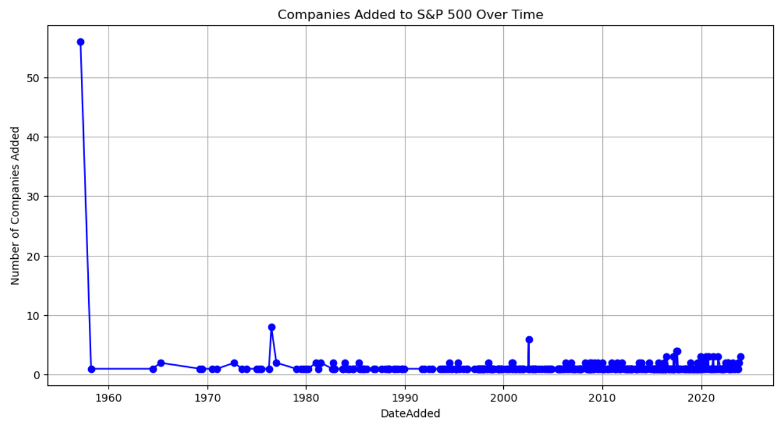
TIME SERIES PLOT
Rapid growth in the technology sector has contributed to a surge in tech companies joining the S&P.
A notable increase in S&P 500 additions occurred in the 1990s and 2000s, reflecting the tech boom and globalization. Since the 2008 financial crisis, additions have slowed, likely influenced by slower economic growth and increased regulatory scrutiny.

Slide 27
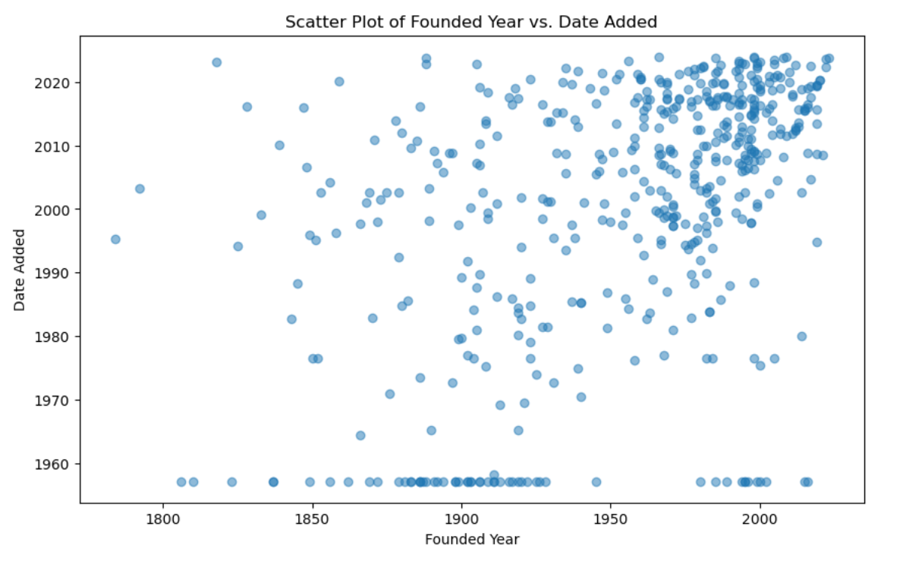
General Trend: A weak negative correlation suggests newer companies are added to the S&P 500 sooner, but with scattered data points and exceptions.
Clustering: Notable clusters include companies founded in the 1950s-1960s added in the 1990s-2000s, and companies founded in the 1990s-2000s not yet added.
Outliers: Instances like a company founded in the 1880s added in the 2010s may be attributed to unique growth patterns or niche industries.
SCATTERPLOT

Slide 28
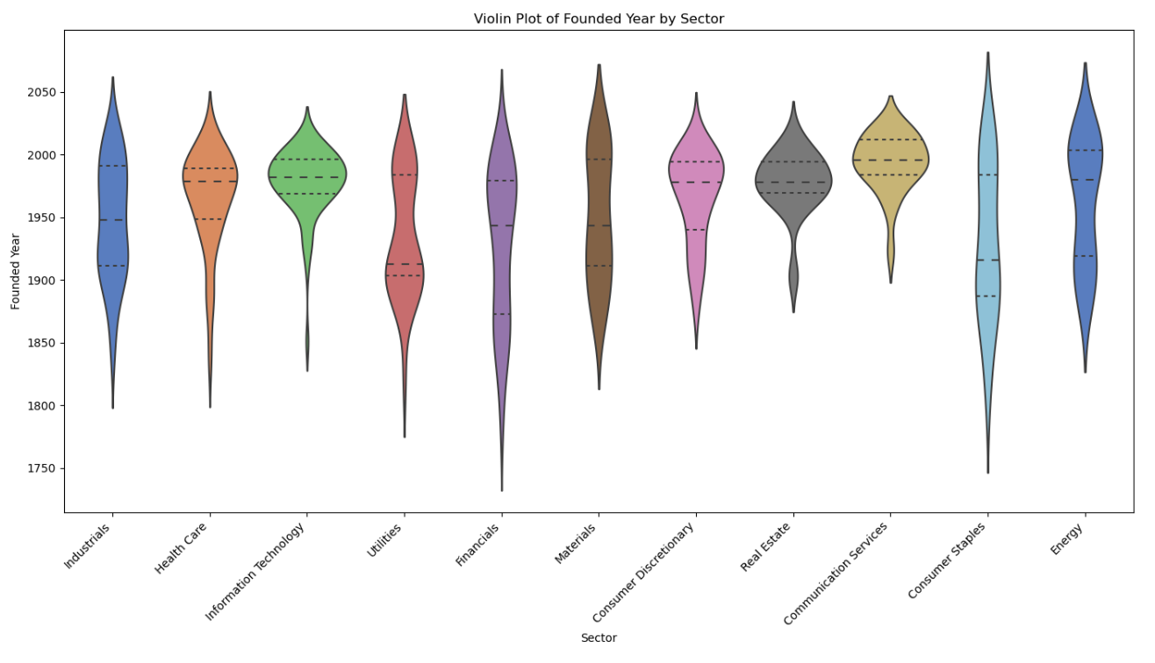
VIOLINPLOT
IT and Communication Services sectors boast the most recent median founding years, centered around 2000.
Industrials and Materials sectors showcase the oldest median founding years, approximately around 1850.

Slide 29
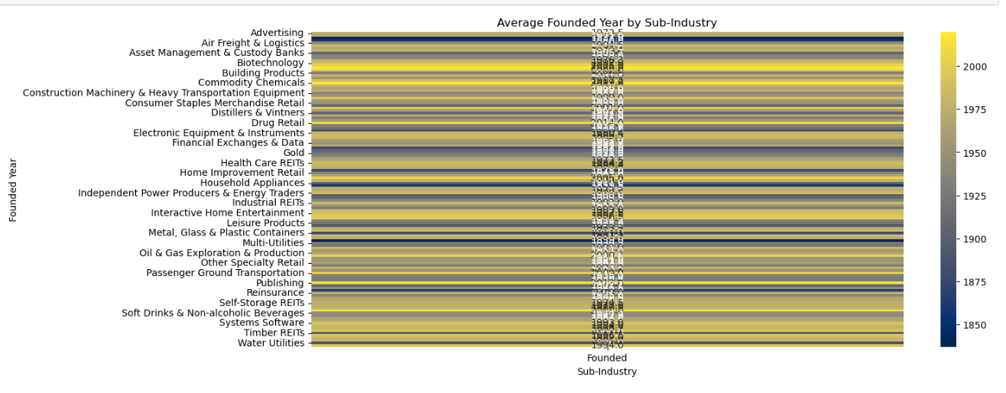
PIVOT TABLE
Activity Disparity: Older sectors like Industrials and Materials exhibit wider distributions of founding years, hinting at historical variability. In contrast, newer sectors like IT and Communication Services show narrower distributions, suggesting more recent and concentrated founding activity.
Outliers Reflect Historical Context: Notable outliers, particularly in older sectors, may be attributed to unique historical circumstances, such as economic upheaval or innovation.

Slide 30
KEY BUSINESS QUESTIONS
1)Which sectors have consistently outperformed others over the years, and what strategies can businesses adopt to align with these trends?
A.The Information Technology sector has consistently outperformed others, driven by technological advancements. Businesses can align by investing in tech innovation and digital transformation.
2)How has the growing influence of the IT sector affected the overall dynamics of the S&P 500, and what implications does this hold for future investments?
A.The IT sector's growth has reshaped the S&P 500 dynamics, emphasizing the need for tech-savvy investments. Companies should prioritize technology integration for sustainable future returns.
3)What factors contribute to the recent surge in entrepreneurial activity, and how can businesses leverage this trend for innovation and growth?
A.Factors like increased access to funding and a culture of innovation drive the surge in entrepreneurial activity. Businesses can capitalize by fostering innovation, agility, and strategic partnerships.

Slide 31
CONCLUSION (KEY FINDING OVERALL)
KEY FINDINGS
Industry Composition:
Information Technology (IT) is the largest sector in the S&P 500, reflecting its significant impact on the U.S. economy.
Other major sectors include Financials, Health Care, Consumer Discretionary, and Industrials, each playing crucial roles in economic growth.
Sector Growth:
The IT sector has shown significant growth in recent years, underlining the increasing importance of technology in various aspects of our lives.
Changes in sector composition over time suggest dynamic shifts in the economy and emerging industries.
Founding Years Distribution:
Most companies in the dataset were founded between 2010 and 2015, indicating a recent surge in entrepreneurial activity.
The dataset includes a wide range of founding years, from the early 1900s to 2020, highlighting a mix of young and established companies.

Slide 32
S&P 500 Additions:
The number of companies added to the S&P 500 has increased over the decades, reflecting the growth of the American economy.
The 1990s and 2000s were particularly active periods for new additions, likely influenced by the technology boom and globalization.
Overall Economic Trends:
Economic growth, changes in S&P 500 criteria, the rise of technology, and globalization have contributed to the increasing number of S&P 500 additions.
The overall trend suggests a resilient and evolving economy with various sectors playing pivotal roles at different times.

Slide 33
EXPERIENCE/CHALLENGES
CHALLENGES FACED IN WEB SCRAPING AND EDA PROJECT:
Finding the Website: Locating the relevant website containing the required data.
Scraping Website: Extracting data from the website efficiently.
Cleaning the Data: Removing inconsistencies and organizing the data for analysis.
Choosing Visualizations: Selecting appropriate visual representations for effective communication.
CONCLUSION:
The S&P 500 dataset provides valuable insights into the dynamics of the U.S. economy, showcasing sector-specific trends, company founding patterns, and the evolution of the S&P 500 index. These findings contribute to a comprehensive understanding of the economic landscape and can guide strategic decisions in various industries.

Slide 34


Slide 35

THANK YOU

